Slide 1
2.Data pre-processing and feature engineering
Overview
Issues in data
Data cleaning
Data reduction and dimensionality reduction
Data transformation
Lesson learning outcome
Propose data cleaning procedure for a given dataset.
Select suitable feature extraction methods to improve the efficiency of analytical techniques.

Slide 2
Data
Data are observations of real-world phenomena.
  Personal biometric data can include measurements of our minute-by-minute heart rate, blood sugar level, blood pressure, etc.
Each piece of data provides a small window into a limited aspect of reality.
The collection of all of these observations gives us a picture of the whole.
Raw data however, rarely comes in the form and shape that is necessary for data analysis.

Slide 3
Data which need Cleaning
Data in the real world is usually dirty
    incomplete: lacking attribute values, lacking certain attributes of interest, or containing only aggregate data
      e.g., Occupation=“ ” (missing data)
    noisy: containing noise, errors, or outliers
      e.g., Salary=“−10” (an error)
    inconsistent: containing discrepancies in codes or names,
      Age=“42”, Birthday=“03/07/2010”
      Was rating “1, 2, 3”, now rating “A, B, C”

Slide 4
data pre-processing
Data pre-processing, as the name implies, involves curating the data to make it suitable for data analysis.
Common data pre-processing tasks
  Data cleaning
    Deal with incomplete, noisy and inconsistent data
  Data transformation and data discretization
    Converting data into a format required for data analysis

Slide 5
Incomplete(Missing) data
Missing values, as the name suggests, are values we expect to have but we don’t.
In the simplest terms, missing values are empty cells in a dataset that we want to use for analytic goals.
Data may be missing due to several issues such as
  Human error.
  Respondents may refuse to answer a survey question.
  The person taking the survey does not understand the question.
  The provided value is an obvious error, so it was deleted.
  Sensor malfunctions.
  Programing bugs.

Slide 6
Types of missing values
Missing completely at random (MCAR) : With MCAR there is no relationship between the missing data and any other values observed or unobserved within the given dataset.. The fact that it is missing is independent of the remaining variables.
Missing at random (MAR) :When data are MAR, the fact that the data are missing is systematically related to the observed but not the unobserved data. This means that missing values can be explained by variables on which you have complete information.
Missing not at random (MNAR): With MNAR missing values depend on the unobserved data. If there is some structure/pattern in missing data and other observed data can not explain it, then it is Missing Not At Random (MNAR).

Slide 7
Dealing with missing values
Keep them as they are : best approach if data analytic technique can handle missing values
Remove the data objects (rows) with missing values :
  Should be careful not to introduce bias into the dataset, and removing valuable information from the data.
  When the missing values in a dataset are of the type MNAR or MAR, data objects with missing values should not be removed

Slide 8
Dealing with missing values
Remove the attributes (columns) with missing values :
  When most of the missing values in a dataset come from one or two attributes, removing the attributes could be considered.
  However, if the attributes are not absolutely essential to the project, removing the attributes with too many missing values might be the right approach.
  When the number of missing values in one attribute is large enough (roughly more than 25%), estimating and inputting missing values becomes meaningless, and letting go of the attribute is better than estimating missing values.

Slide 9
Dealing with missing values (Contd.)
Estimate and impute a value :
  Analytic tools are used to fill missing values.
  If the missing values are of the MCAR or MAR type and the analytic chosen cannot process the dataset with missing values, imputing the missing values might be the best approach.
  Imputing with the general central tendency (mean, median, or mode), regression analysis and interpolation are possible.

Slide 10
Outliers
Outliers or extreme points, are data objects whose values are too different than the rest of the population.
Outliers could occur due to errors in data and outliers that are not errors can skew the results of analytic tools that are sensitive to the existence of outliers.
Detecting outliers
  Univariate outlier detection : Box plots, bar charts
  Bivariate outlier detection : scatter plots, color coded contingency tables
  Multivariate outlier detection: Cluster analysis

Slide 11
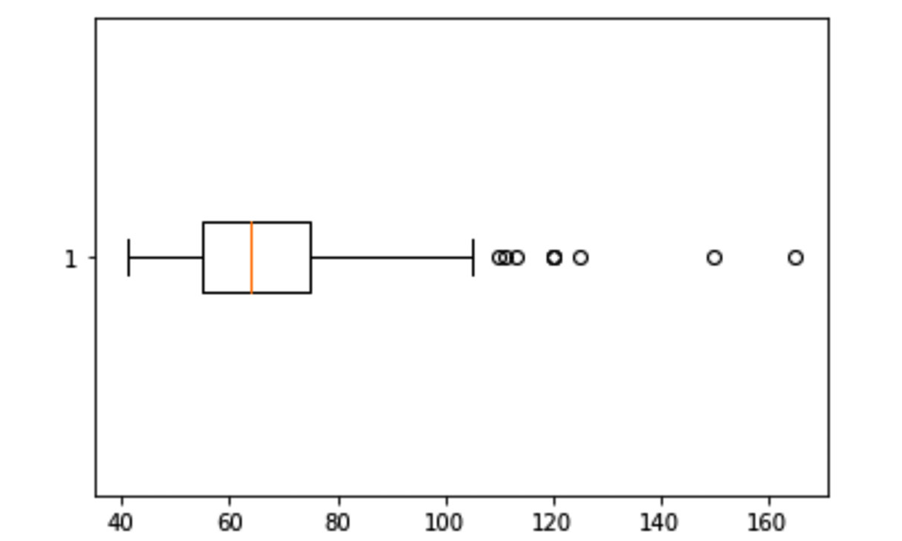
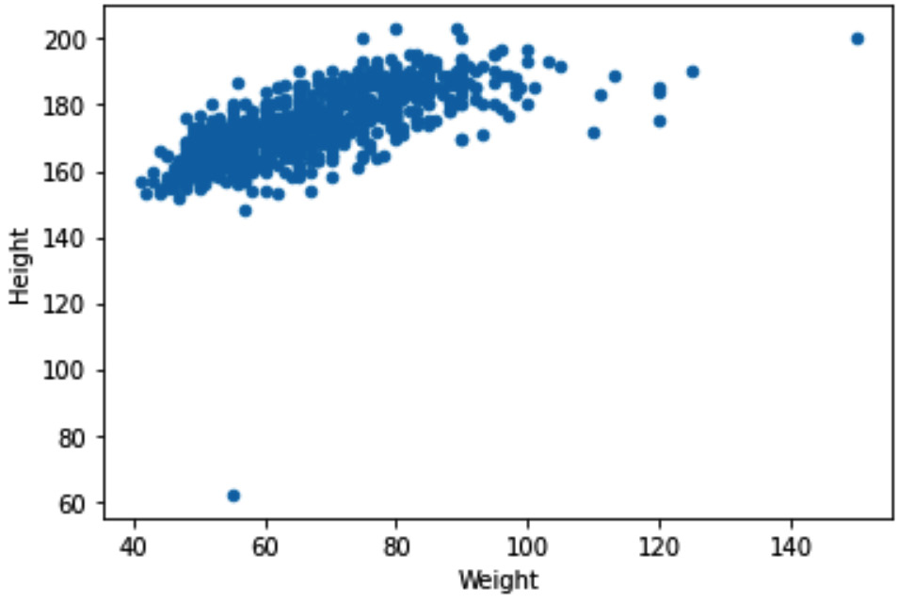
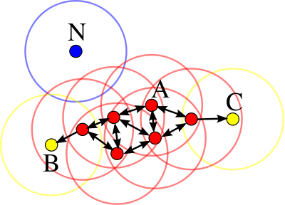
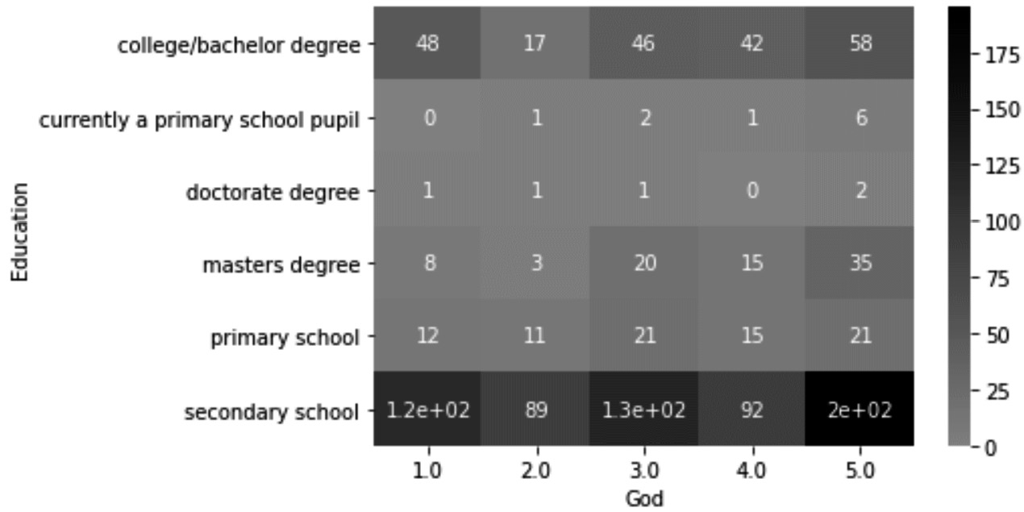
Outlier detection
Box Plot
Scatter Plot
Contingency table
Clustering

Slide 12
Approaches to deal with outliers
Do nothing : This is done when analytic tools can easily handle outliers.
Replace with the upper cap or lower cap : The method is used for univariate outliers when we do not want to lose information by removing data objects.
Remove data objects with outliers

Slide 13
Data reduction
Data reduction is about reducing the size of data due to one of the following three reasons:
High-Dimensional Visualizations: When we have to pack more than three to five dimensions into one visual, we will reach the human limitation of comprehension.
Computational Cost: Datasets that are too large may require too much computation. This might be the case for algorithmic approaches.
Curse of Dimensionality: Some of the statistical approaches become incapable of finding meaningful patterns in the data because there are too many attributes.

Slide 14
Objectives of data reduction
There are two objectives of data reduction.
  First, data reduction seeks to obtain a reduced representation of the dataset that is much smaller in volume.
  Second, it tries to closely maintain the integrity of the original data, which means making sure that data reduction will not lead to including bias and critical information being lost in the data.
There are two types of data reduction methods.
  Numerosity data reduction : performs data reduction by reducing the number of data objects or rows in a dataset
  Dimensionality data reduction. performs data reduction by reducing the number of dimensions or attributes in a dataset

Slide 15
Numerosity data reduction
Some numerosity data reduction techniques are follows:
  Random Sampling: Randomly selecting some of the data objects to avoid unaffordable computational costs.
  Stratified Sampling: Randomly selecting some of the data objects to avoid the unaffordable computational costs, all the while maintaining the ratio representation of the sub-populations in the sample.
  Random Over/Under Sampling: Randomly selecting some of the data objects to avoid the unaffordable computational costs, all the while creating a prescribed representation of the sub-populations in the sample.

Slide 16
Dimensionality reduction
The number of input variables or features for a dataset is referred to as its dimensionality.
Dimensionality reduction is used to reduce the number of attributes (columns) in a data set.
More attributes often make a predictive modeling task more challenging to model, more generally referred to as the curse of dimensionality.

Slide 17
Dimension reduction techniques
  Dimensionality reduction techniques can be categorized into two broad categories
  Feature selection :The feature selection method aims to find the most relevant subset of the input variables from the original dataset. Feature selection includes three strategies, namely:
    Filter strategy
    Wrapper strategy
    Embedded strategy
  Feature extraction : Feature extraction, converts the data from the high-dimensional space to one with lesser dimensions. This technique finds a smaller set of new variables, each of which is a combination of input variables (containing the same information as the input variables).

Slide 18

Filter methods
Filter methods are generally used as a pre-processing step.
The selection of features is independent of any machine learning algorithms.
Instead, features are selected on the basis of their scores in various statistical tests for their correlation with the outcome variable.

Slide 19
Examples for filter methods
Chi-square test —
    Chi-square method (X2) is generally used to test the relationship between categorical variables.
    It compares the observed values from different attributes of the dataset to its expected value.
    In the test, Chi-square between each feature and the target is obtained and desired number of features with the best Chi-square scores are selected.
    X2 test requires: the variables have to be categorical, sampled independently and values should have an expected frequency greater than 5.

Slide 20
Examples for filter methods
Correlation Coefficient –
  Pearson’s Correlation Coefficient is a measure of quantifying the association between the two continuous variables and the direction of the relationship with its values ranging from -1 to 1.
  Through correlation, we can predict one variable from the other.
  The logic behind using correlation for feature selection is that the good variables are highly correlated with the target.
  Furthermore, variables should be correlated with the target but should be uncorrelated among themselves.
  If two variables are correlated, we can predict one from the other.
  Therefore, if two features are correlated, the model only really needs one of them, as the second one does not add additional information
  If we find that the predictor variables are correlated among themselves, we can drop the variable which has a lower correlation coefficient value with the target variable

Slide 21
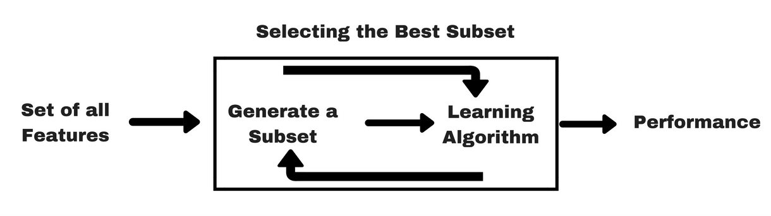
Wrapper methods
Wrappers require some method to search the space of all possible subsets of features, assessing their quality by learning and evaluating a classifier with that feature subset.
The feature selection process is based on a specific machine learning algorithm that we are trying to fit on a given dataset.

Slide 22
Wrapper methods (contd.)
Forward Feature Selection
  This is an iterative method wherein we start with the best performing variable against the target.
  Next, we select another variable that gives the best performance in combination with the first selected variable.
  This process continues until the preset criterion is achieved.
Backward Feature Elimination
  This method works exactly opposite to the Forward Feature Selection method.
  Here, we start with all the features available and build a model.
  Next, we the variable from the model which gives the best evaluation measure value. T
  This process is continued until the preset criterion is achieved.
  This method can be used when building Linear Regression or Logistic Regression models

Slide 23
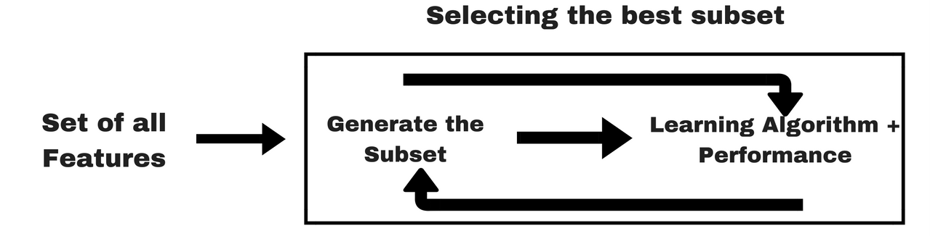
Embedded methods
These methods encompass the benefits of both the wrapper and filter methods, by including interactions of features but also maintaining reasonable computational cost.
Embedded methods are iterative in the sense that takes care of each iteration of the model training process and carefully extracts those features which contribute the most to the training for a particular iteration.
Some of the most popular examples of these methods are LASSO and RIDGE regression which have inbuilt penalization functions to reduce overfitting

Slide 24
Other feature selection techniques
Random forest
    Random forest, as the name suggests, instead of just relying on one decision tree to perform classification or prediction, uses many small decision trees in a randomized way.
    These smaller decision trees are called weak predictors or classifiers.
    As a dimension reduction method, the number of times each attribute appeared in the multiple weak decision trees is looked at and arrive at a percentage of decision trees that each attribute was employed by.

Slide 25
Feature extraction techniques
Principal Component Analysis
  PCA is a linear dimensionality reduction technique (algorithm) that transforms a set of correlated variables (p) into a smaller k (k<p) number of uncorrelated variables called principal components while retaining as much of the variation in the original dataset as possible.
  A principal component is a linear combination of the original variables
  Principal components are extracted in such a way that the first principal component explains maximum variance in the dataset
  Second principal component tries to explain the remaining variance in the dataset and is uncorrelated to the first principal component
  Third principal component tries to explain the variance which is not explained by the first two principal components and so on

Slide 26
Data transformation
Normalization and standardization
Binary coding, ranking transformation, and discretization
Attribute construction
Log transformation
Smoothing, aggregation, and binning

Slide 27
Normalization and standardization
Normalization typically means rescales the values into a range of [0,1].
Standardization typically means rescales data to have a mean of 0 and a standard deviation of 1 (unit variance).
When to use standardization and normalization
  Data analytics technique require the range of all the attributes in a dataset to be equal
    This will be needed especially for algorithmic data analytics that uses the distance between the data objects. (e.g. KNN, K-Means)
  Data analytics technique require variance and/or the standard deviation of all the attributes to be equal.
    E.g. PCA

Slide 28
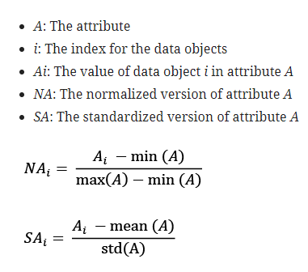
Min-max normalization and standardizing
Ex: using salary vs GPA for analysis

Slide 29
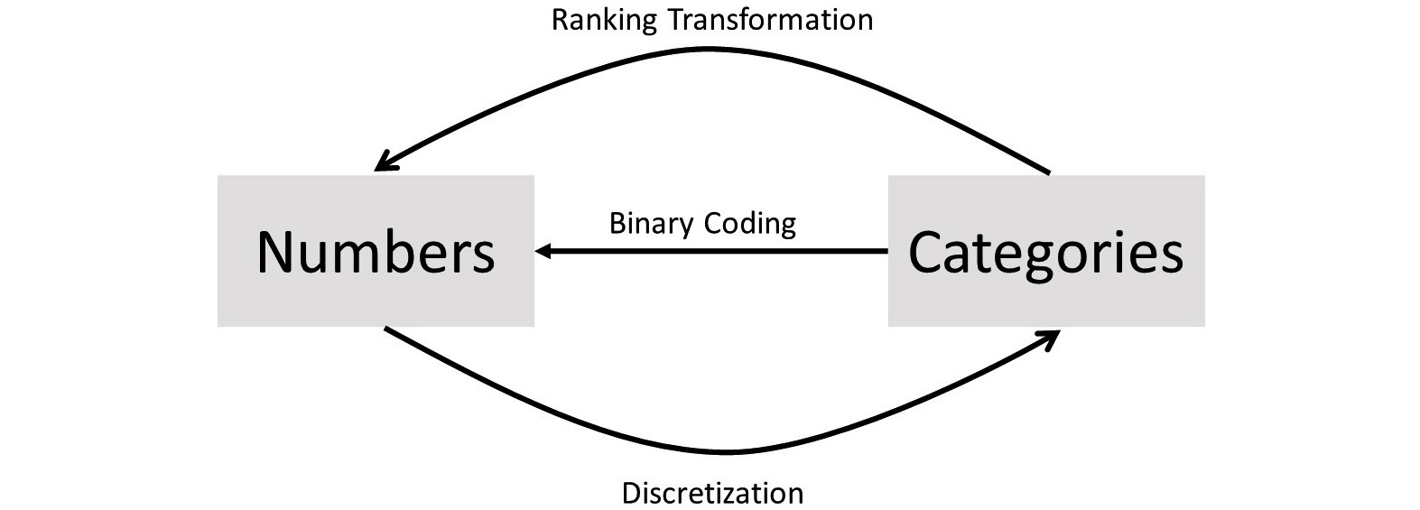
Binary coding, ranking transformation, and discretization
Sometimes it is required to transform numerical representation to categorical representation, or vice versa.
To do these transformations binary coding, ranking transformation, and discretization could be used.

Slide 30
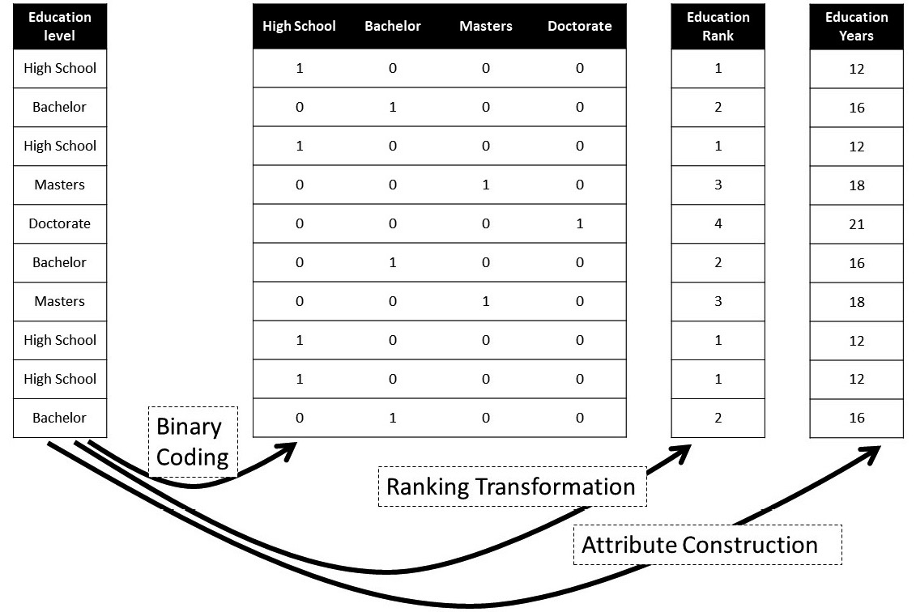
Example : Binary coding, ranking transformation and attribute construction

Slide 31
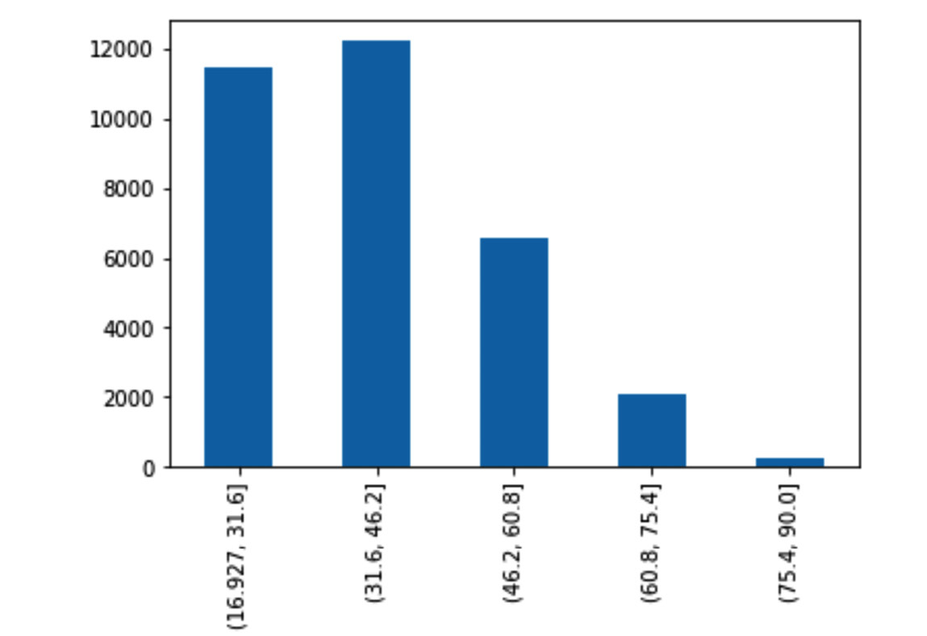
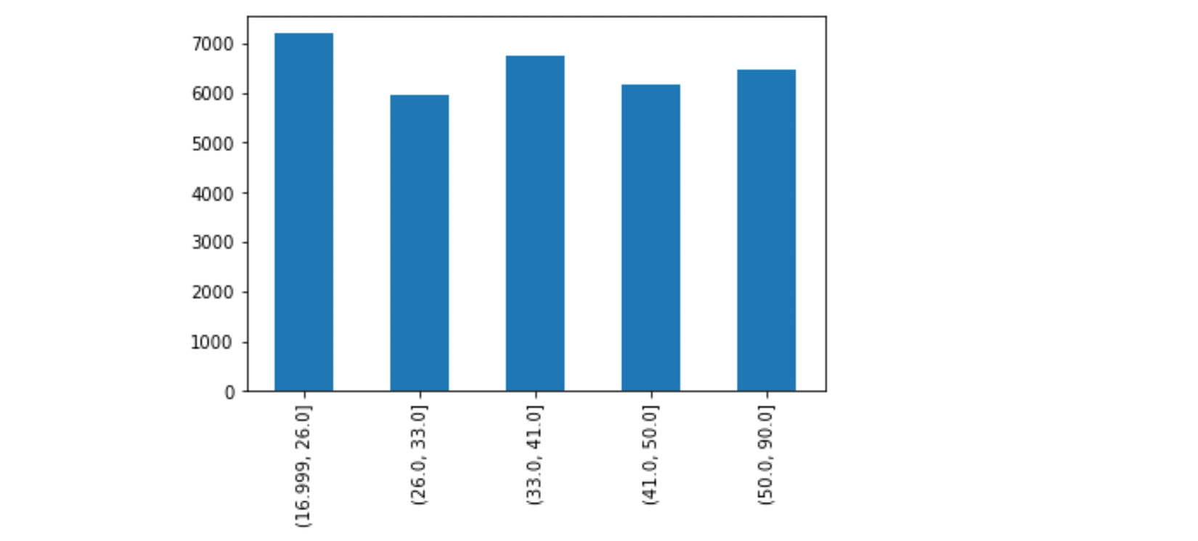
Discretization
Equal width: equal width approach makes sure that cut-off points will lead to equal intervals of the numerical attribute
Equal frequency : aims to have an equal number of data objects in each bin.
Ad hoc approach : cut-off points are determined based on the knowledge about the attribute.

Slide 32
Attribute construction
Attribute Construction uses the knowledge about the original attribute to assume more accurate information into the transformed data.
  Example : as we know, achieving any of the degrees in the Education Level attribute takes a different number of years of education.
Attribute construction can also be done by combining more than one attribute.
  Example: determining whether a person is healthy by interpreting the BMI received based on height and weight)

